Slide 1
Predicting Zodiac Signs from OKCupid Profiles
A Machine Learning Exploration
November 2025
Gabriel Arcangel Bol

Slide 2
Project Goals & Motivation
Goals
Predict whether a user's zodiac sign can be inferred from their OKCupid profile.
Explore which profile features (text, lifestyle attributes, demographics) contribute to this prediction.
Practice a full machine-learning pipeline: EDA → Feature Engineering → Modeling → Evaluation.
Motivation
Zodiac signs are common in dating preferences.
If predictable, this could enhance user matching or preference filtering.

Slide 3
Dataset Overview
Dataset: OKCupid profiles.csv
59,946 users
31 columns: demographics, lifestyle choices, text-based essays
Mix of structured categorical, numerical features, and large free-text fields
Challenges
High missing values in lifestyle fields
Essays are long, noisy, and informal
Zodiac distribution nearly uniform → hard classification task

Slide 4
Research Questions
Can we accurately classify zodiac signs based on OKCupid profile data?
Do text-derived features (e.g., sentiment) improve prediction?
Which machine learning models perform best for this task?
What can regression teach us when applied to a different target (e.g., age)?

Slide 5
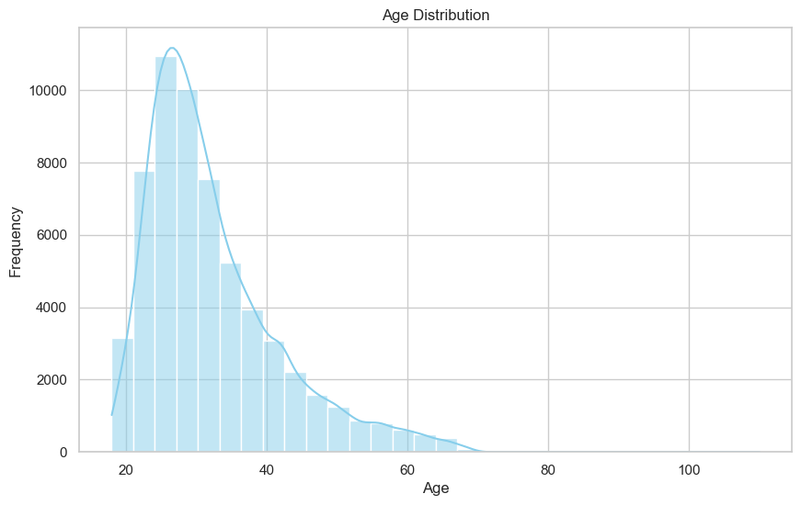
Exploratory Data Analysis (EDA)
Key Insights
Most users are between 25 and 35 years old (Right-Skewed Distribution).
Very few users over 50, limiting predictive power for older demographics (Strong age skew).
Slight differences across gender but overall similar shapes.

Slide 6
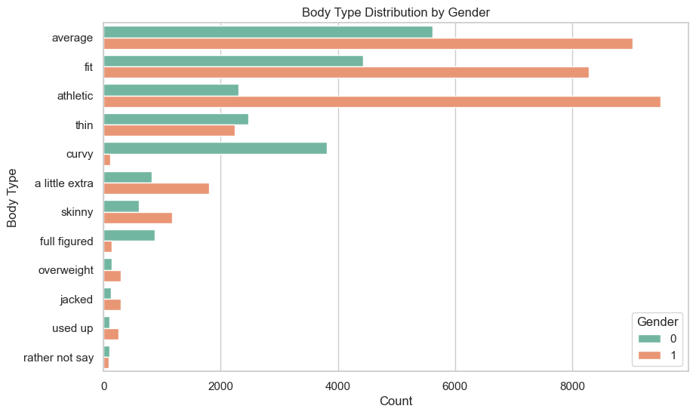
Categorical Exploration: Body Type by Gender
Key Insights
The perception of 'Body Type' is heavily gendered.
Men tend to self-report as 'average' or 'fit' more frequently.
Women are more likely to report as 'athletic' or 'average'.
This difference highlights the subjectivity and bias present in self-reported categorical data.

Slide 7
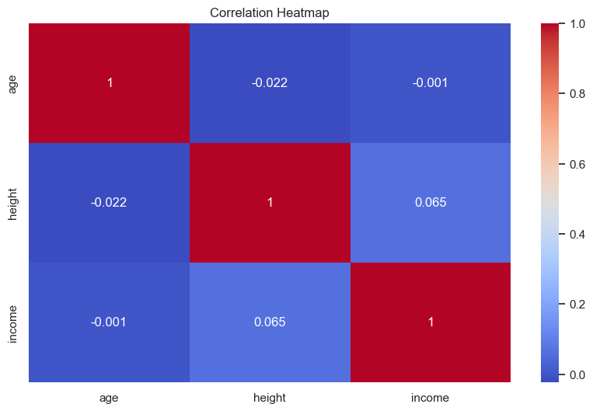
Feature Analysis: The Missing Predictive Signal
Key Findings:
• Weak Correlation: The correlation matrix reveals near-zero linear relationships between key profile features and the zodiac target.
• Text Data Noise: Essay features (TF-IDF) were too subjective and noisy to capture astrological patterns.
• Conclusion: The features simply do not encode the information necessary for prediction.

Slide 8
Data Cleaning & Preprocessing
Steps Performed
  Removed extreme outliers (age, height, essay length)
  Filled missing lifestyle attributes as "unknown"
  Dropped highly incomplete columns (if any)
  Normalized numeric features: age, height, income
  Encoded categorical features:
    Label Encoding for ordinal-like categories
    One Hot Encoding for nominal categories

Slide 9
Feature Engineering (New Columns Created)
1. essays_combined
Concatenated all essay fields into one text column.
Simplifies text processing, avoids sparse features.
2. sentiment score
Computed using TextBlob polarity (−1 to 1).
Captures overall positivity / negativity in user writing.
Why these matter
Text is the richest source of personal expression.
Sentiment might correlate with personality, lifestyle, or zodiac-related traits.

Slide 10
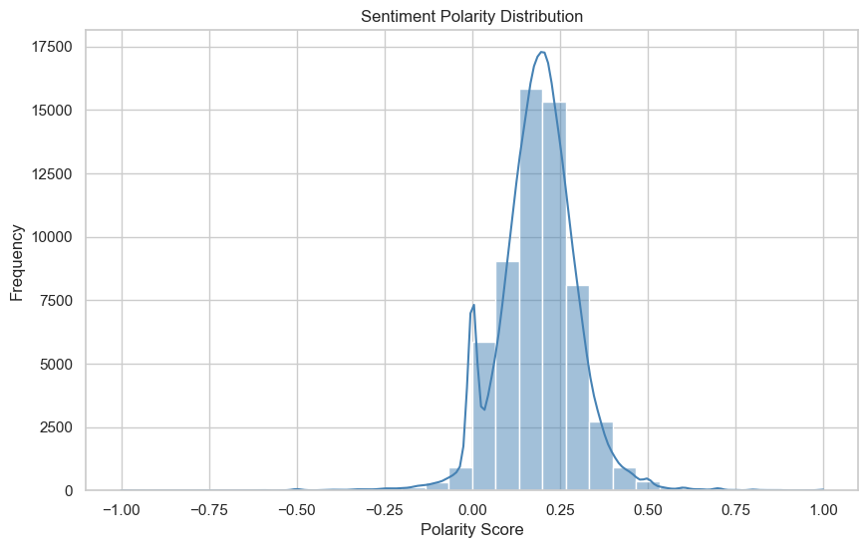
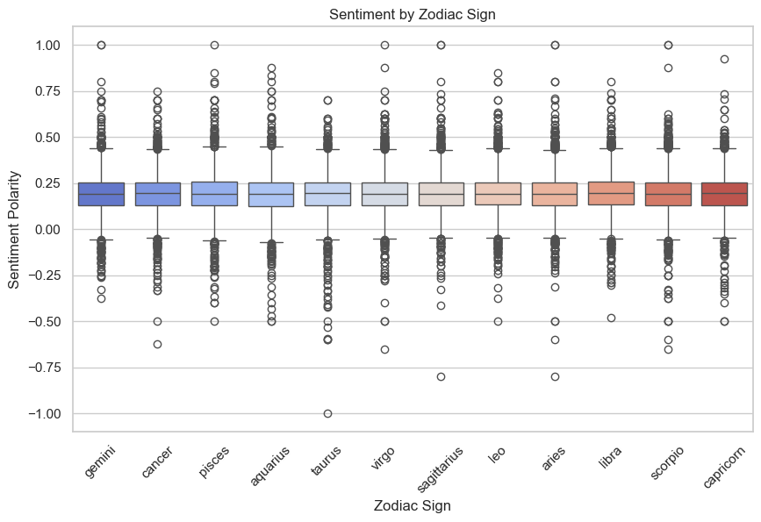
Sentiment Features from Essays
Insight
Sentiment is approximately normally distributed around 0.
No strong differences across zodiac signs.
Suggests that sentiment is not predictive for this task, but still useful to test.

Slide 11
Classification Models Tested
Models Evaluated
  Logistic Regression
  K-Nearest Neighbors (KNN)
  Linear SVC
  Naive Bayes
  Random Forest (optimized)
Performance Summary
  All models achieve 8–9% accuracy, close to random guess (≈ 1/12 ≈ 8.3%).
  Naive Bayes: fastest (~0.2s)
  Logistic Regression: slowest (~7.5s)
  Random Forest: best accuracy, but still low.

Slide 12
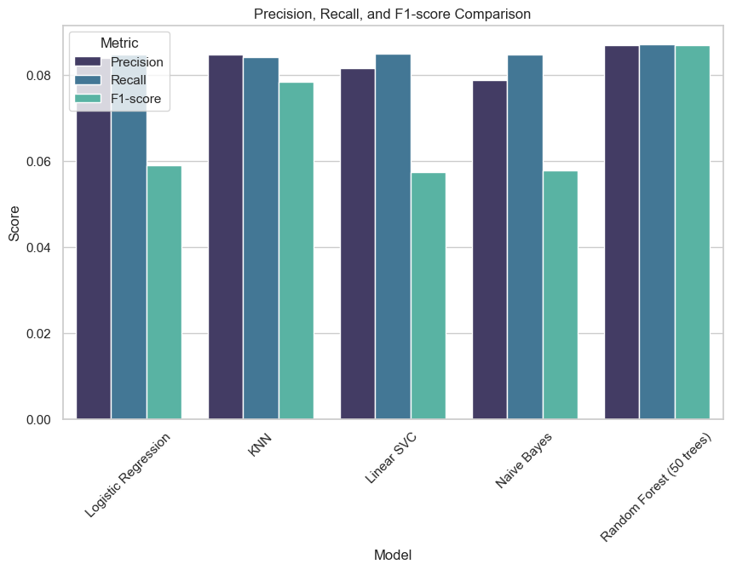
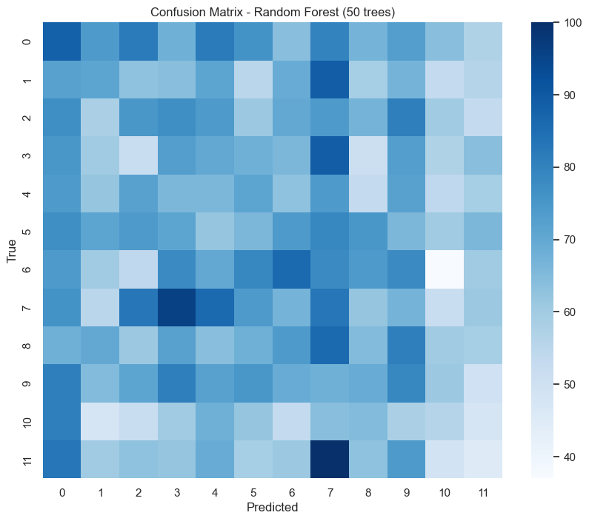
Model Performance Summary: Low Signal-to-Noise
Classification (Zodiac Prediction):
Accuracy: All models achieved ~8.5% Accuracy, equivalent to random guessing.
Takeaways
Confusion matrix shows heavy confusion across all zodiac classes.
No model meaningfully outperforms random guess.
The features simply do not encode zodiac information.

Slide 13
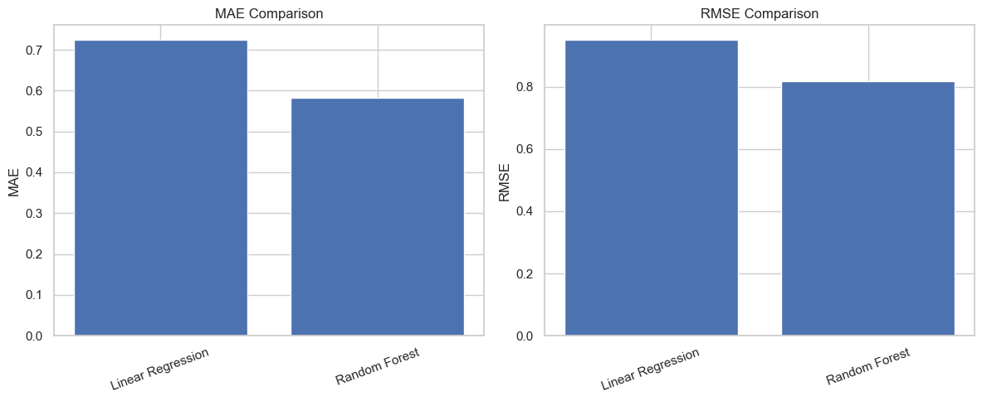
Regression Analysis (Age Prediction)
Key Regression Findings:
Linear Regression: Fastest, but lowest accuracy (R² = 0.12).
Random Forest Regressor: Better performance (R² = 0.27) but still limited.
Insight
While age is more predictable than the zodiac sign, the essays alone are insufficient for robust numerical prediction.

Slide 14
Key Findings
Zodiac prediction is not feasible using structured or sentiment-based features.
Data shows no strong correlation between zodiac and profile attributes.
Model performance is nearly random regardless of technique.
Good reminder: Not all real-world questions are learnable problems.

Slide 15
Final Conclusions & Key Takeaways
Data Quality: Real-world social data is often messy and subjective.
Core Issue: Sentiment and demographic/lifestyle features add noise, not predictive power.
Final Insight: This project reinforces the importance of critical evaluation. Not all research questions are "learnable" problems using the given data.

Slide 16
Strategic Next Steps & Future Work
Reframed Task: Pivot the project to predict more learnable traits (e.g., Smoking Habits or Diet Preference from the essay text).
Advanced NLP: Explore deep learning text embeddings (BERT, DistilBERT) to capture semantic meaning more effectively than TF-IDF.
Unsupervised Learning: Use clustering (K-Means) to identify Dating Archetypes or persona groups.

